Slide 1
Books Recommendation System
[Group No:1]

Slide 2
Project Objective
This project is aimed at creating a recommender system of books for individual users depending upon what they have read previously and thus make more sales and give most apt recommendation to customers.

Slide 3
Project Road-Map
EDA
Data Visualization
Feature Engineering
Model Building
Deployment

Slide 4
Introduction to Recommendation System
Recommendation system involves predicting user preferences for unseen items
Recommending relevant products increases the customers' interest and sales of the company
Examples:
Facebook – “People You May Know”
Amazon –”Customers Who bought this item also bought…”

Slide 5
Dataset Details
There are three datasets provided separately,
Books (271360, 8)
Columns-ISBN,Title,Author,Year of Publication,Publisher,Images-S,M,L
User (278858, 3)
Columns-UserID,Age,Location
Ratings (1149780, 3)
Columns –UserID,ISBN,Book rating

Slide 6
Data Preprocessing
Books
Check Null Values and missing data
The value 0 for Year-Of_Publication is invalid and as this dataset was published in 2004, We have assumed that the years after 2006 to be invalid and setting invalid years as NaN
There are some incorrect entries in Year-Of-Publication field. It looks like Publisher names 'DK Publishing Inc' and 'Gallimard' have been incorrectly loaded as Year-Of-Publication in dataset due to some errors in csv file. Required correction done.

Slide 7
Data Preprocessing
Users
In Age column, unrealistic age range ie above 100 and below 5 are imputed with NaNs.
Location column – 57339 unique Value it's really hard to understand So created column “Country”

Slide 8
Data Preprocessing
Ratings
Ratings Ratings dataset should have books only which exist in our books dataset
It can be seen that many rows having book ISBN not part of books dataset got dropped off
Ratings dataset should only have ratings from users which exist in users dataset.
It can be seen that no new user was there in ratings dataset.

Slide 9
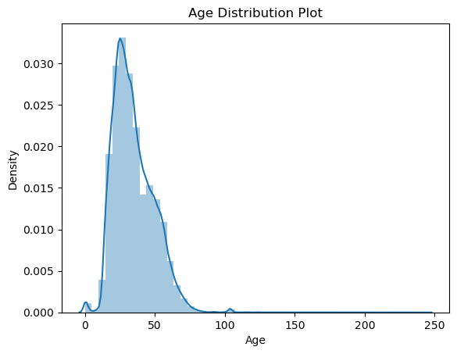
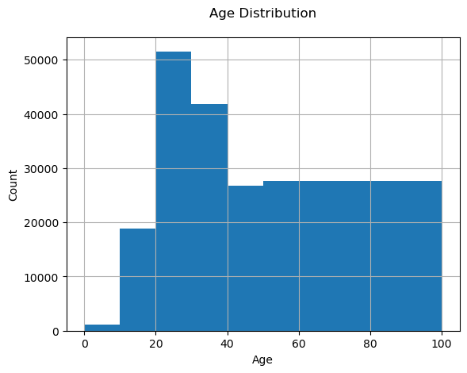
EDA & Visualization

Slide 10
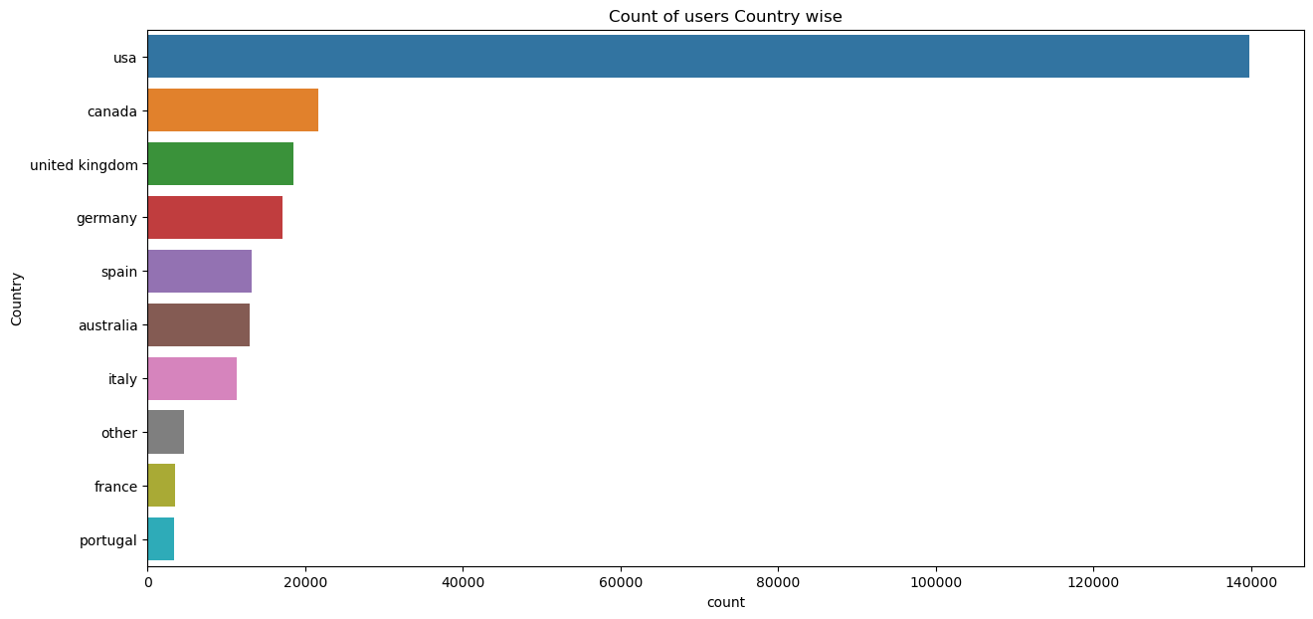
Country wise users

Slide 11
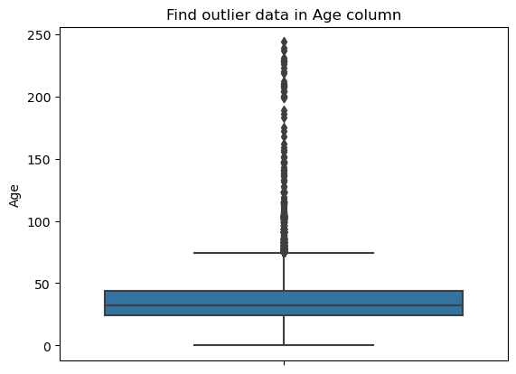
Box plot showing outliers in Age column

Slide 12
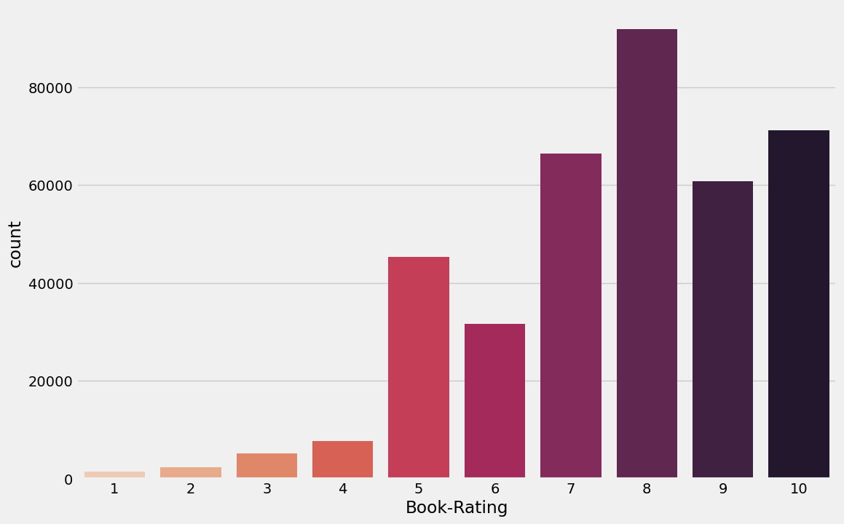
Book Rating Count-plot

Slide 13
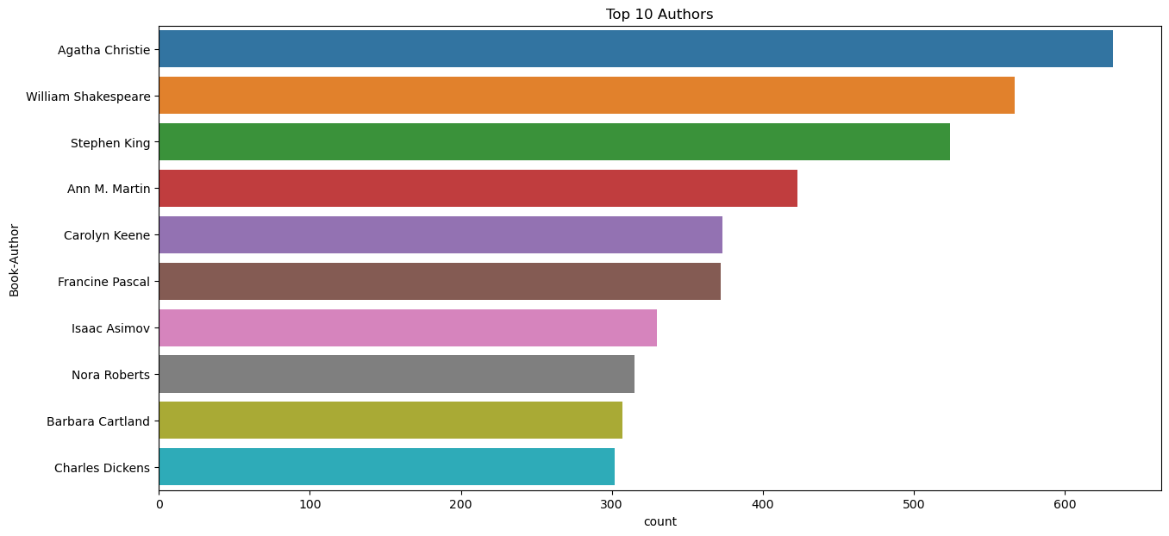
Top 10 Authors

Slide 14
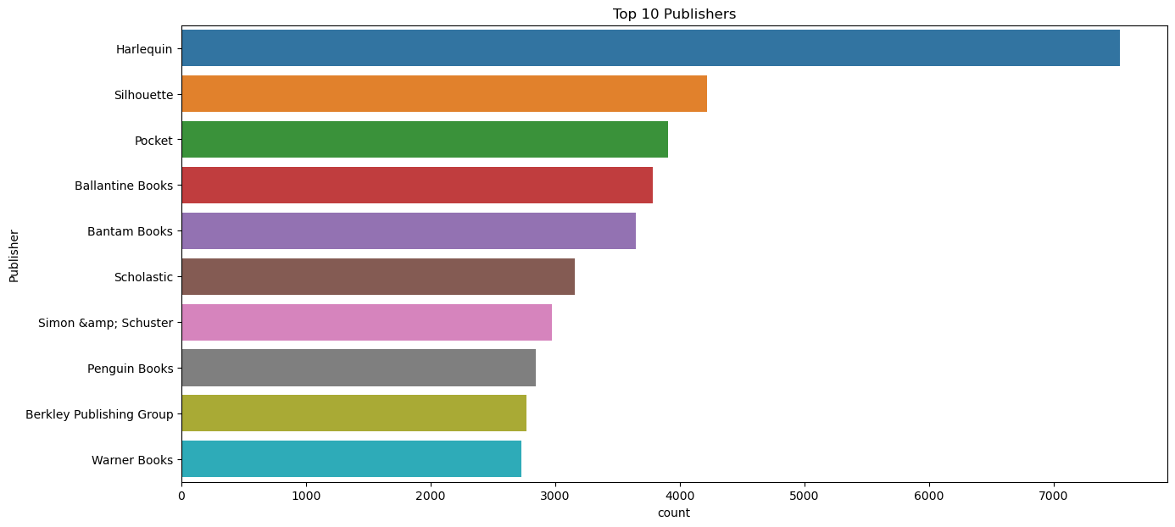
Top10 Publishers

Slide 15
EDA Conclusion
In EDA, the Top-10 most rated books were essentially novels.
Books like The Lovely Bone and The Secret Life of Bees were very well perceived.
Majority of the readers were of the age bracket 20-35 and most of them came from North American and European countries namely USA, Canada, UK, Germany and Spain.
If we look at the ratings distribution, most of the books have high ratings with maximum books being rated 8. Ratings below 5 are few in number.
Author with the most books was Agatha Christie, William Shakespeare and Stephen King.

Slide 16
Recommendation Techniques
Popularity Based Recommendation : Works on the principle of popularity and or anything which is in the trend. These systems check the books or movies that are in trend or are most popular among the users and directly recommend those.
Colllaborative Filtering: It finds similiar patterns or information of the users. It can filter out items that users like on the basis of ratings or reactions by similar users.
Item-Item Filtering: Recommends similar items in-terms of ratings by users.
User-Item Filtering: Recommends the items liked by a similar user say A to a user B who have not seen the items.

Slide 17
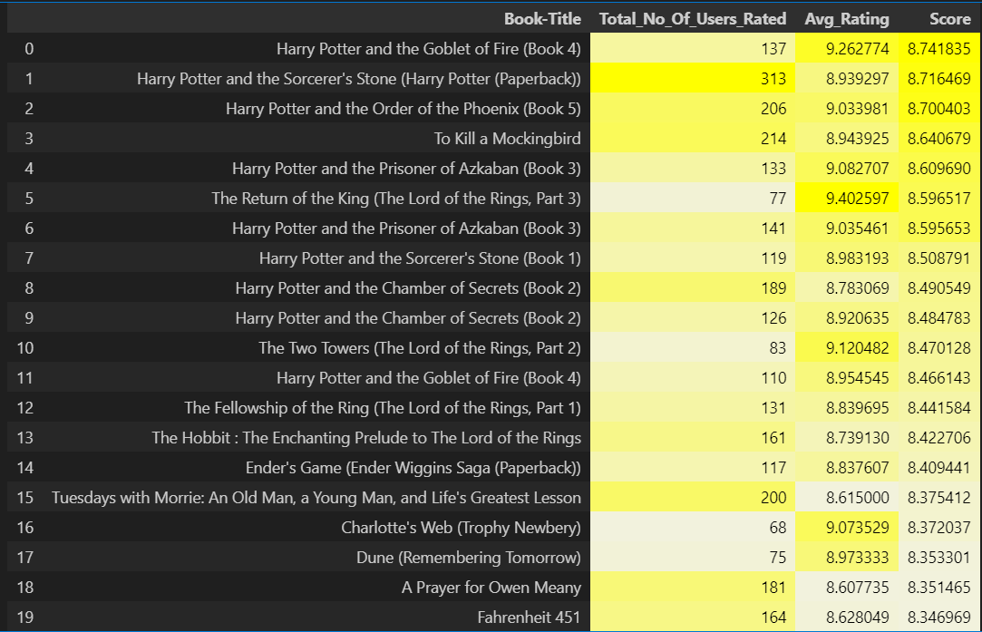
Popularity Based Recommendation

Slide 18
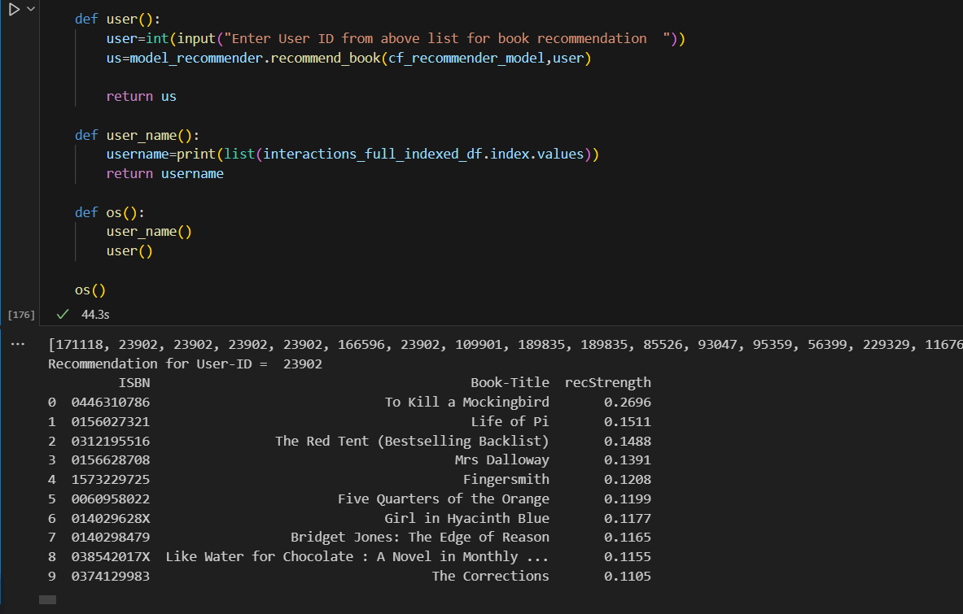
Collaborative filtering : User->item

Slide 19
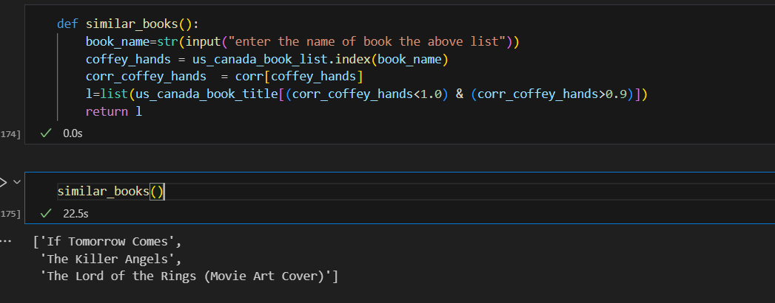
Collaborative Filtering: item->item

Slide 20
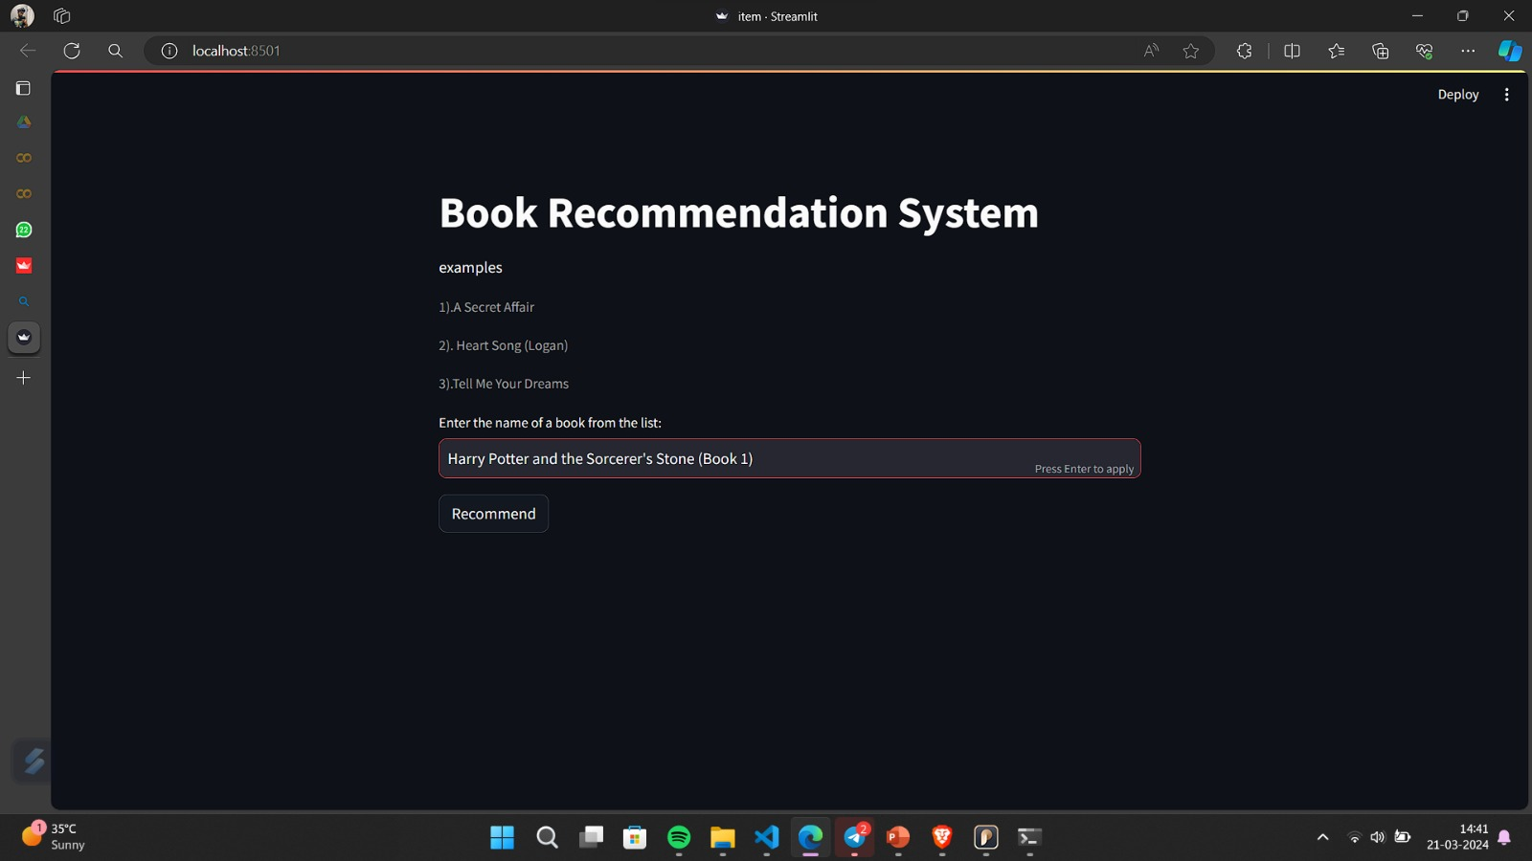
Deployment Page

Slide 21
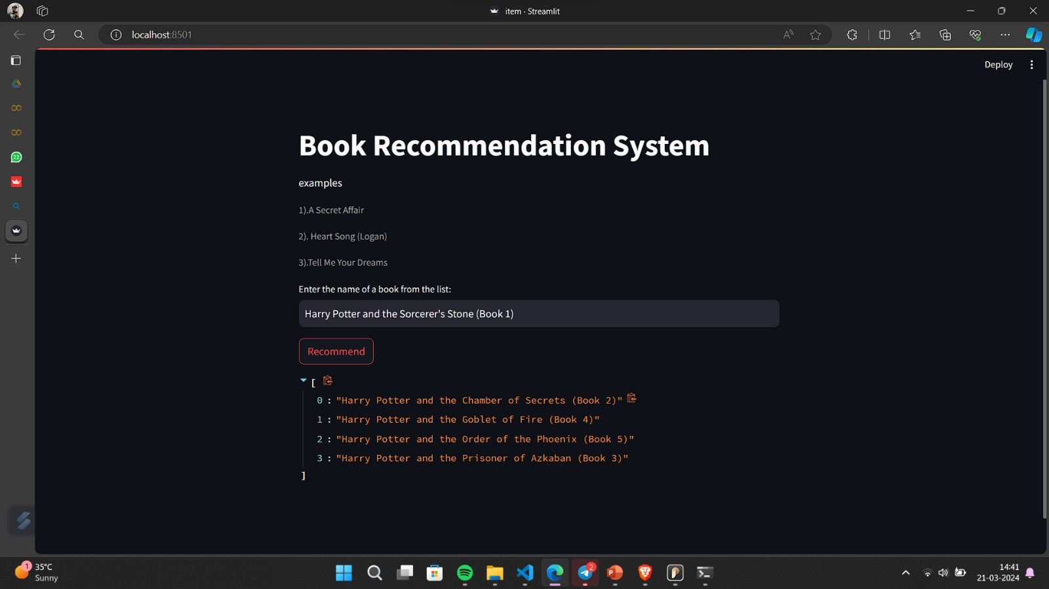
Deployment Result

Slide 22
Thank you
Group members
Harikrishnan
Pranav
Anith
Barsha Mirsha
Rojalin Mishra

